Slide 1
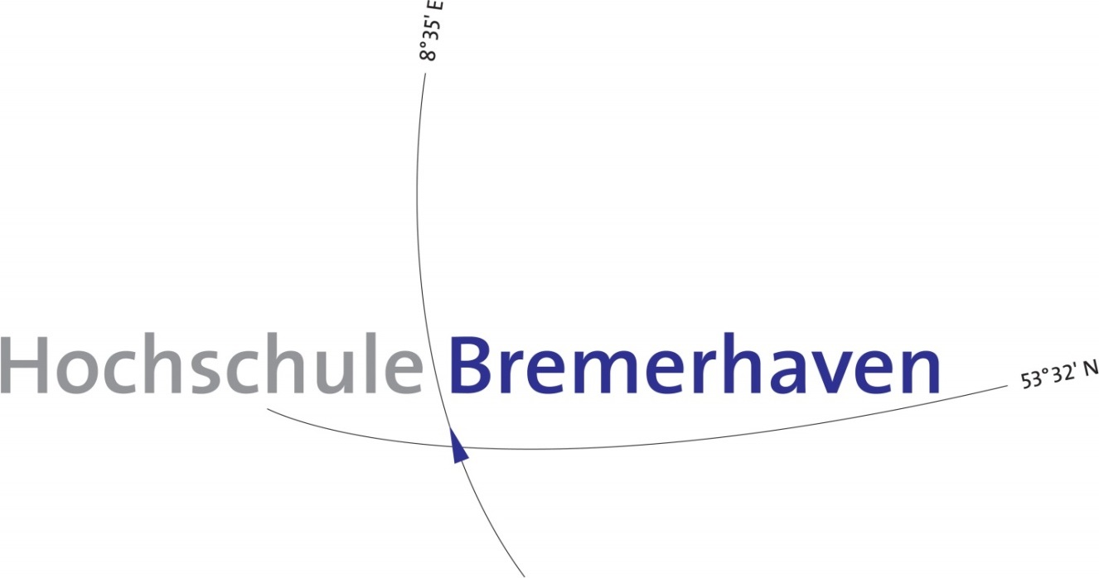
Flight Angle Control
Project Presentation

Slide 2
Sensor Integration
Introduction
Hardware
Basic Calculations and Formulae
Filters and Fusion Algorithm
Comparison with Graphs

Slide 3
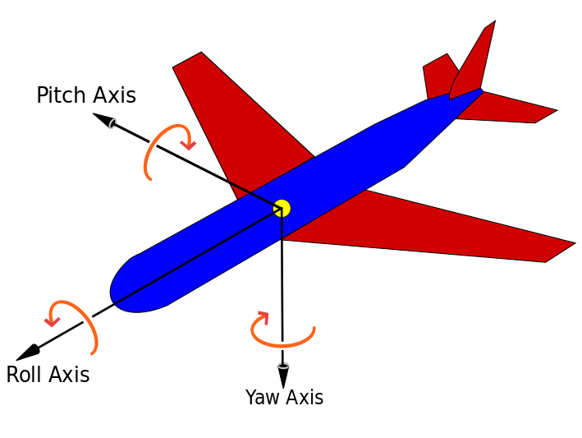
Introduction
We need to measure three angles i.e. Roll, Pitch and Yaw angles.

Slide 4
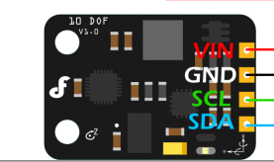
Hardware
We are using Arduino MEGA 2560
Microcontroller ATMega 2560
We are using SEN0140 Sensor.
Adxl345 accelerometer
ITG3200 gyro
HMC5883L Compass
BMP085 pressure sensor
Interface: I2C

Slide 5
Basic Calculation
Yaw angle
To accurately measure Yaw angle we need to make use of magnetometer. (It detects North).
We have used drivers provided by the vendor to get the values of Heading.
Next, we need to Measure Roll and Pitch.
We are making use of Accelerometer and Gyro.

Slide 6
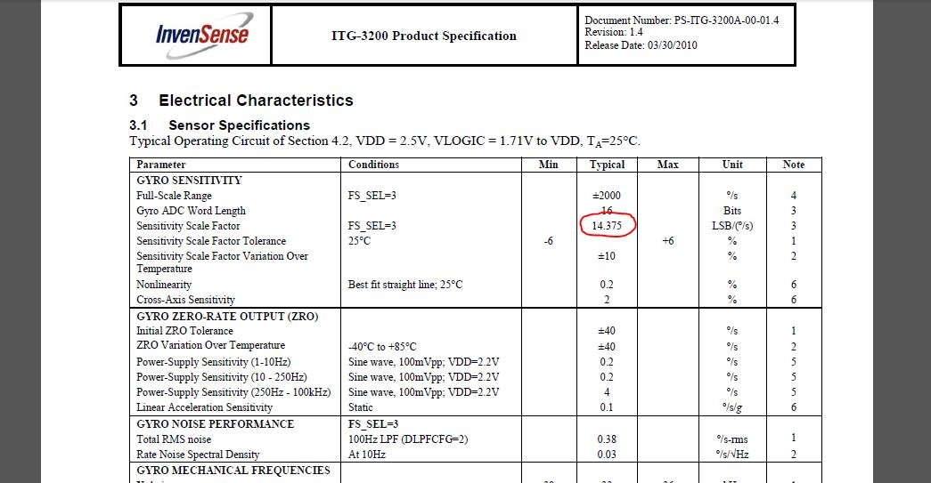
Continued..
Gyro
It measures angular motion in degree/second i.e. Angular motion/time.
Output of ITG3200 will be 14.375 when the angular motion is 1°/Sec.

Slide 7
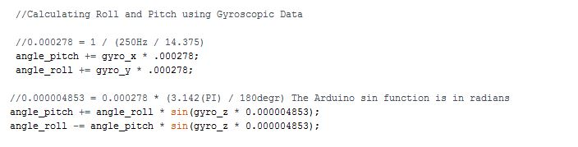
Continued..
Therefore, to convert angles into degrees:
Angle_in_degrees=(raw_gyro_output/14.375)
Most of the flight controllers will have a refresh rate of 250Hz (1/4 ms).
Z(out)/250/14.375= Z(out) *0.000278
Using above equation we can get to know the travelled angle.
We need make use of Yaw angle to calculate Roll and Pitch.
Pitch angle Vs. Yaw angle is a sin function.
We have used above algorithm in code to calculate Roll & Pitch:

Slide 8
Disadvantage of Using only Gyro:
Gyroscope has two major problems:
Gyro is (little)slow to respond to changes and also, over time Gyro will drift it’s angles.
Gyro always need a reference value when initiated. If initiated on a surface that is angled, then gyro is most likely to fail.
Hence next we try Accelerometer.

Slide 9

Accelerometer
Accelerometer Adxl345 measures proper acceleration. To calculate Roll and Pitch we make use of following formula as written in the code:

Slide 10

Fusion Algorithm.
Both Gyro and Accelerometer have advantages and disadvantages. Hence we should try to get best out of both by combining them.
Complementary Filter:
Its an alternative and simple solution compared to Kalman Filter. It works as below:
Angle=(1-Weight)*Gyro+ (weight)* Accelerometer.
We have implemented complementary Filter to calculate Pitch and Roll

Slide 11
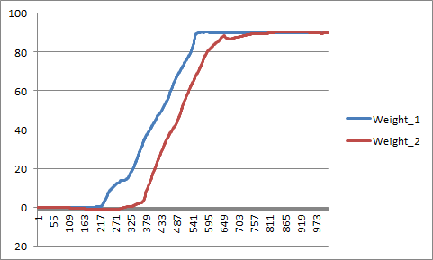
Comparison With Graph

Slide 12
Comparison With Graphs

Slide 13
Cont’d
Additionally, We have also made use of Low-pass filter to avoid Noise.
Filter_val=(1-weight)*Filter_val + (weight)*new_val
When the IMU is initiated the Accelerometer value has to be assigned to Gyro Value. This makes sure, Gyro will always have a reference value.

Slide 14
Motor Integration
So Far,
Communication between BL-CTRL V3.0 and Arduino which makes use of I2C protocol.
Testing the motor for different RPM using Arduino.
Getting feedback from motor.(RPM, Temperature, State etc.)

